Slide 1



Brainhack Dallas 2019
Saturday, Nov. 16- Sunday Nov. 17

Slide 2
Welcome

Slide 3
Introduce the Team
Ekarin
.
Made website
..
(Will talk about
R/RStudio)
Ju-Chi
.
Logistics with BBS
..
(Not your TA today)
Matt
.
Talk about data
visualization
..
(He is a Dr. !)
David
.
Advocated for food
..
(He likes food)
Micaela
.
Teach
Git/GitHub
.
(….)

Slide 4

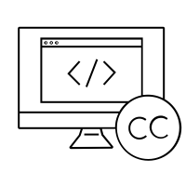

The purpose of Brainhack?
Share your research to other brainhack attendees
Learn about current open science practices and data
Find exciting open science projects that you would like to contribute to
Notes:
BrainHacks are collaborative events that focus on the open sharing of ideas, models, code, and data. They bring together brain experts and enthusiasts from a variety of backgrounds to build relationships, learn from one another, and collaborate on projects related to the neurosciences

Slide 5
Our schedule for the next 2 days

Slide 6
Logistics
Lunch, rooms, power strips, etc.

Slide 7
Code of Conduct
https://www.brainhack.org/code-of-conduct.html

Slide 8
Projects
Can I pitch a project?
Yes.
What is the criteria?
The outcome of it is something open-to-all
A tool/script/function
Processed data that is open
A tutorial/textbook
A group of you can pitch something together:
Example: human brain surface atlas in R

Slide 9
Projects
What if we have something that we use in the lab?

Slide 10


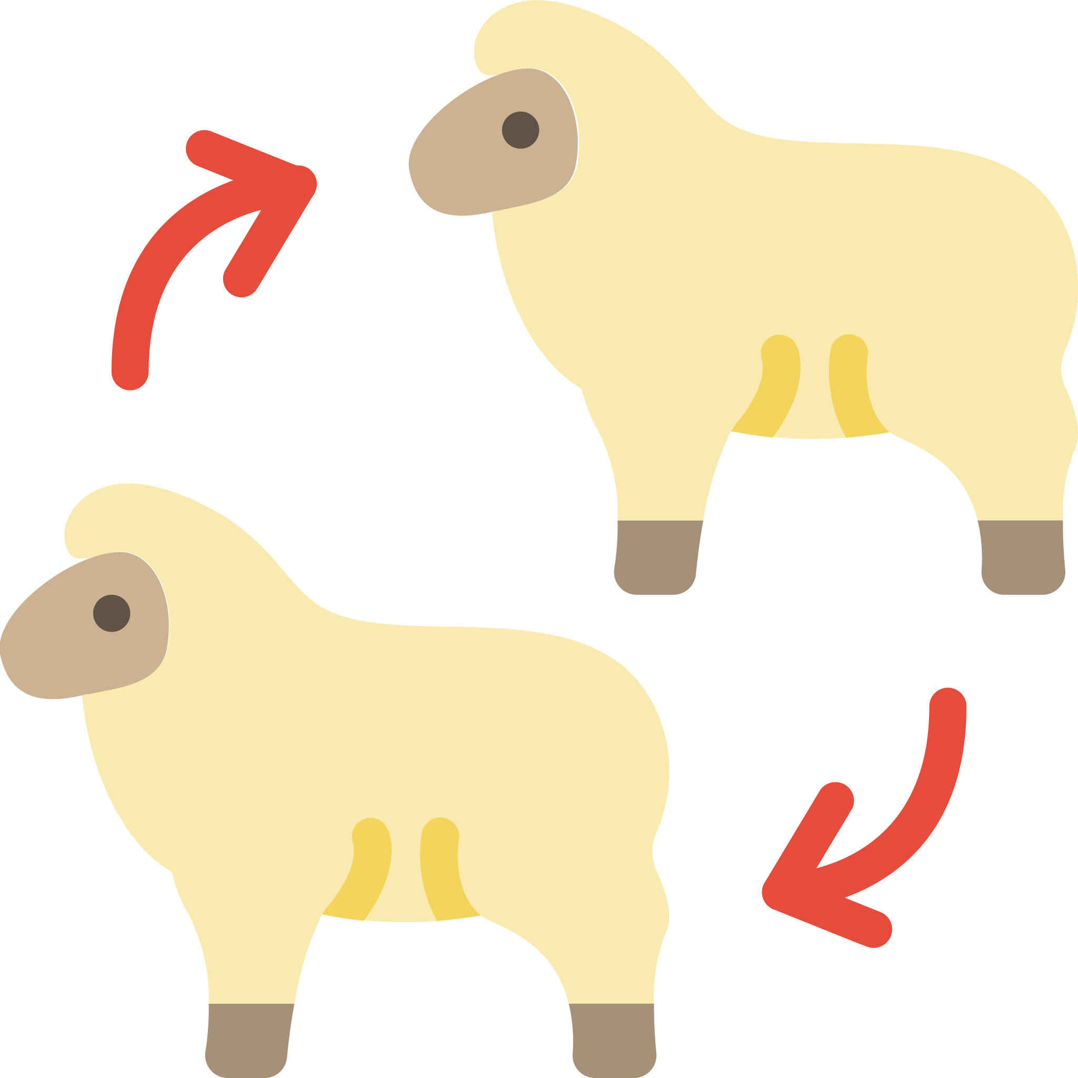

For those who are familiar with GitHub: Fork & Pull Request
Fork and Pull Request
Add & Commit Changes
Fork the project repo on GitHub &
Clone it to your computer
Track your changes using Git
Push changes to GitHub
Make a
pull request
The original owner of the repository can review your changes before incorporating it

Slide 11
Install-fest
Install Git & GitHub Desktop
Install R, RStudio

Slide 12
Obtain the project you are interested in working on
Fork a project so a repository of that project is now in your GitHub account
Fork the project repo on GitHub
Clone the repository to your computer
Use GitHub Desktop
File >> Clone Repository
OR do it via the command line
Clone it to your computer

Slide 13
Look at what has been done in the project
History tab in GitHub Desktop
> git log
Notes:
git log

Slide 14

Make some changes to the project & document the changes
Add a file….
Look at what has changed
Change Tab on GitHub Desktop
Commit the change
Type a summary and click
Add & Commit Changes
Track your changes using Git
> git add <file>
> git commit

Slide 15
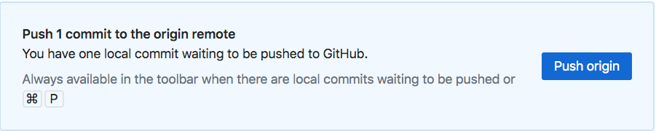
Push that change to GitHub
Push changes to GitHub
> git push

Slide 16
Check that your change is now on GitHub

Slide 17
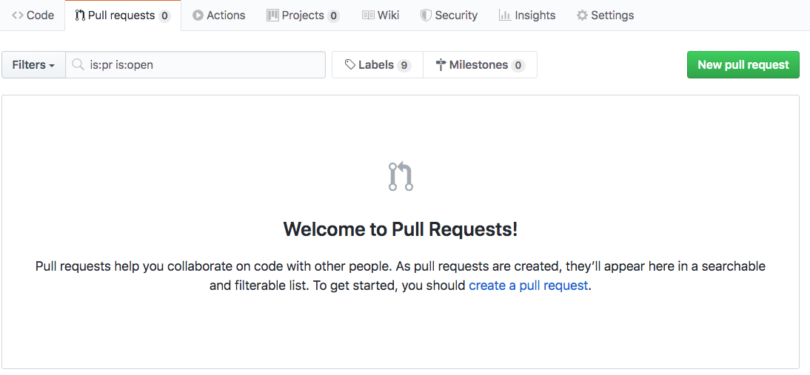
Ask the original author to incorporate your changes
Make a
pull request

Slide 18
Add & Commit Changes
Fork the project repo on GitHub &
Clone it to your computer
Track your changes using Git
Push changes to GitHub
Make a
pull request
For the purpose of this Brainhack, you don’t have to touch the command line if you don’t want to.

Slide 19
Add & Commit Changes
Fork the project repo on GitHub &
Clone it to your computer
Track your changes using Git
Push changes to GitHub
Make a
pull request
For the purpose of this Brainhack, you don’t have to touch the command line if you don’t want to.

